Slide 1
Multiple object Detection and Recognition (YoLo/R-CNN) (Computer Vision)
Bakul Gohel, Ph.D.
DA-IICT, Gandhinagar

Slide 2
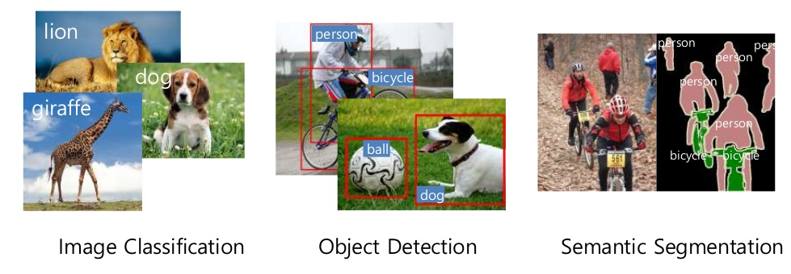
Computer Vision
Object Detection and Recognition(Classification)
Easy Hard
Image classification containing single Object
Location of object in a image is not detected
Multiple Object detection in a image
Where ?

Slide 3
YoLo : You Only Look Once

Slide 4
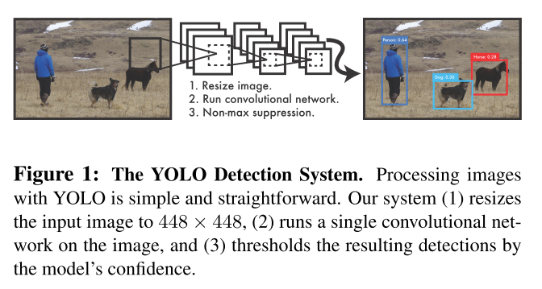
YoLo- You Only Look Once
Input -> Image
Output -> multiple object(s) classification with bounding box

Slide 5
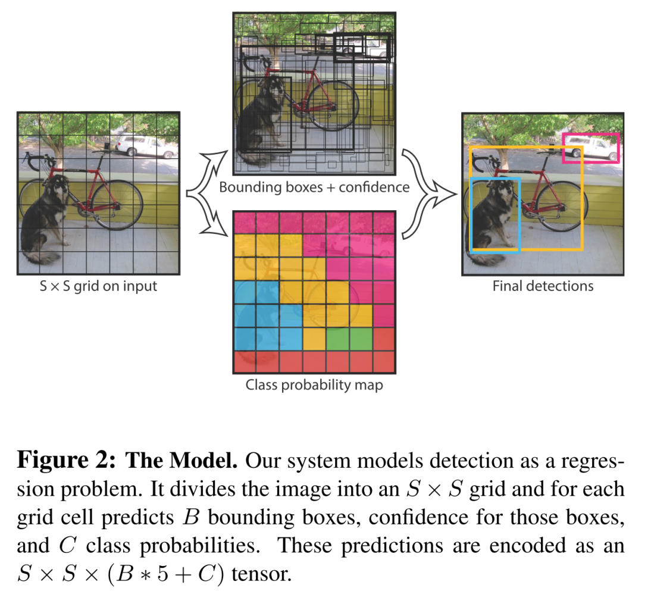

YoLo- You Only Look Once
Input -> Image
Output -> multiple object(s) classification with bounding box
During Testing
Object
Classification
Object Detection
Joseph Redmon et. al. 2015

Slide 6
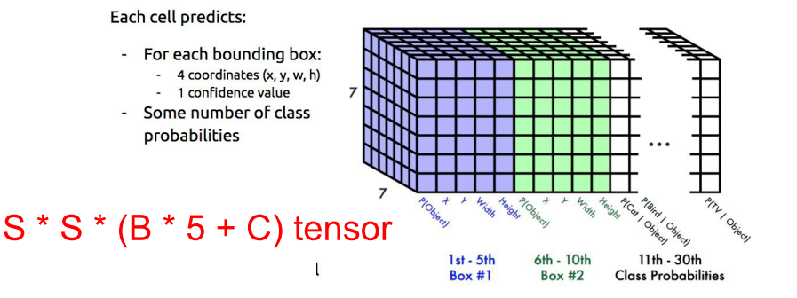
YoLo- You Only Look Once
If the centre of an object falls into a grid cell, that grid cell
Each bounding box consists of 5 predictions: x, y, w, h, and conﬁdence.
The (x, y) coordinates represent the centre of the box relative to the bounds of the grid cell. The width and height are predicted relative to the whole image
Pascal VOC dataset has 20 object classes
Number of Boxes(possible objectes per grid cell)=2

Slide 7
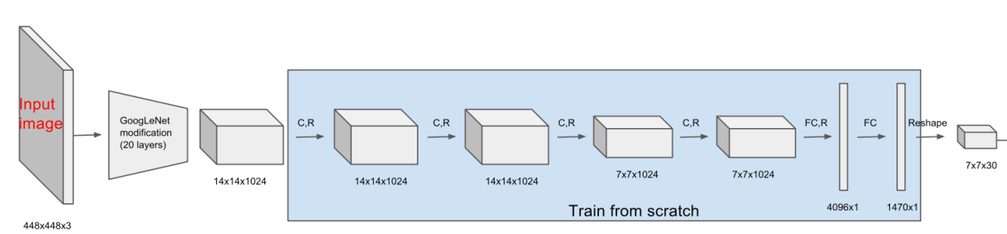
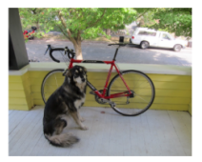
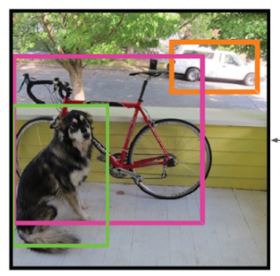
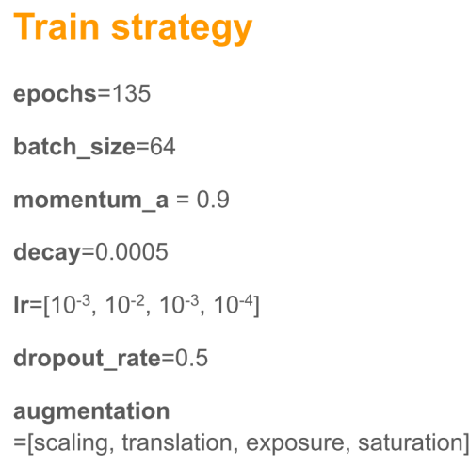
YoLo- You Only Look Once
One stage regression (object classification + object detection + object localization)
Feature extractor
(pre-trained with image net dataset)
Object Classification and regression
(trained with target dataset)
Regression
(linear activation + MSE loss)

Slide 8
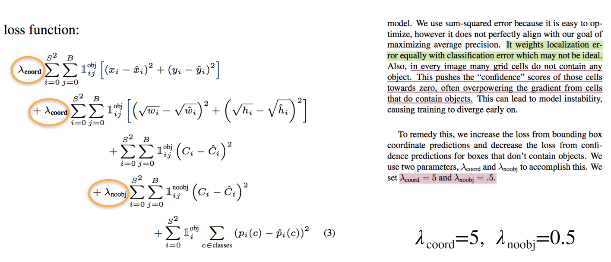
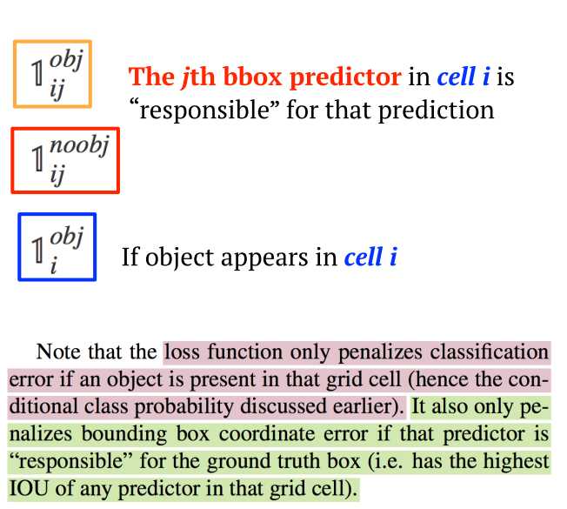
YoLo- You Only Look Once
Joseph Redmon et. al. 2015

Slide 9
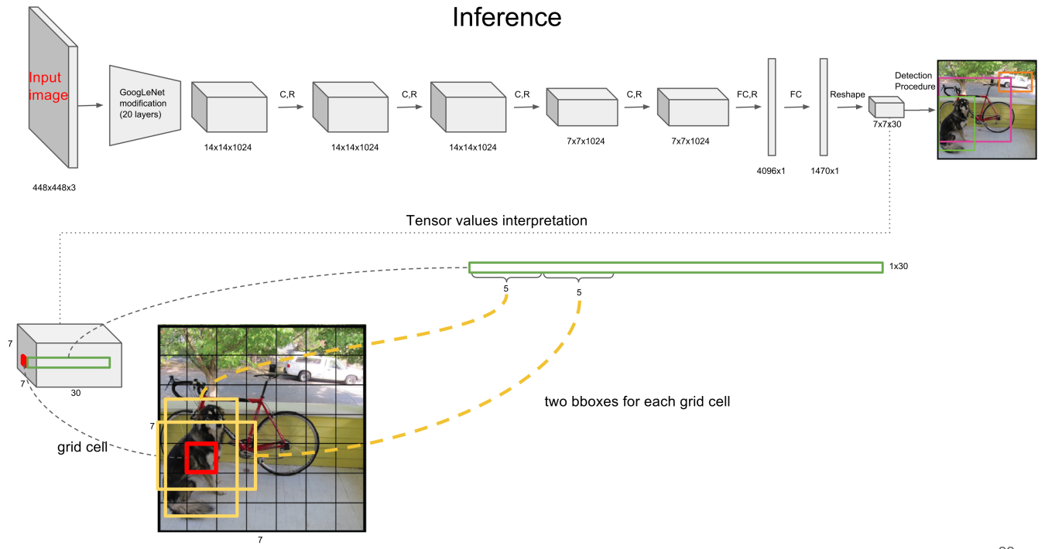
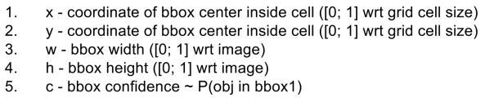
YoLo- You Only Look Once
20 class probabilities

Slide 10
YoLo- You Only Look Once
20 class probabilities

Slide 11
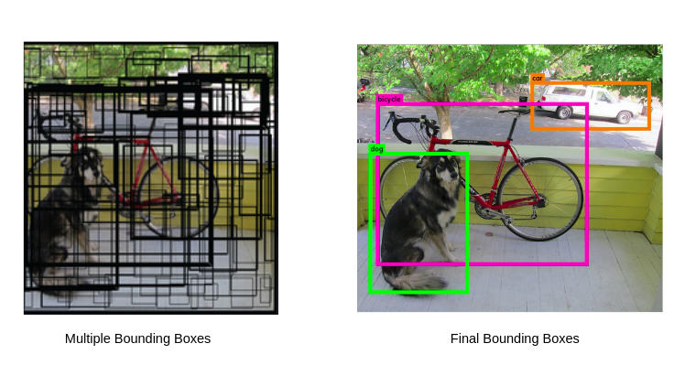
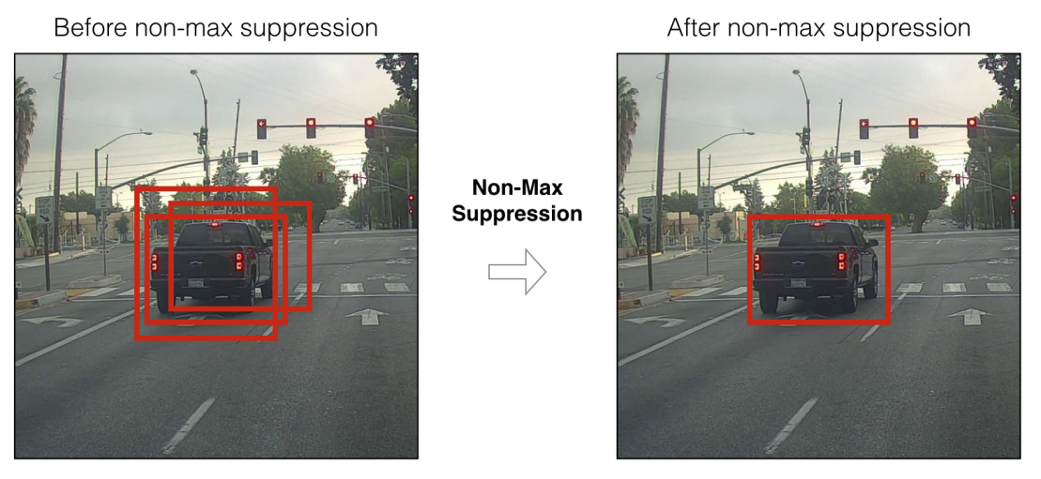
Non-Maximum Suppression- NMS
It is likely that there are multiple overlapping bounding box prediction for same object
We need to prune bounding box with lesser confidence and higher IoU with bounding box with higher confidence for a given object class
For more detail please look at : https://www.analyticsvidhya.com/blog/2020/08/selecting-the-right-bounding-box-using-non-max-suppression-with-implementation/ or other resources

Slide 12
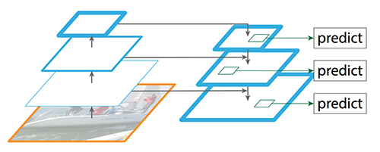
Feature Pyramid Network

Slide 13
R-CNN : Region CNN
For more resource you may refer:
https://lilianweng.github.io/lil-log/2017/12/31/object-recognition-for-dummies-part-3.html#faster-r-cnn

Slide 14
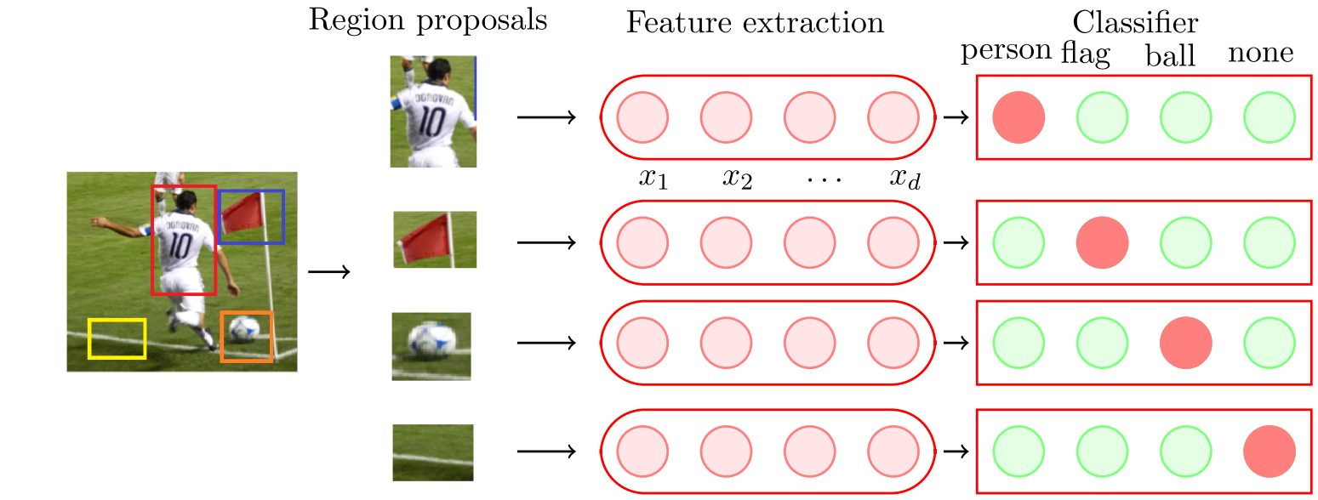
Object Detection and Recognition
General frame work is first detect the Object
Then, perform object classification or recognition step
Classifier
SVM
ANN
CNN

Slide 15
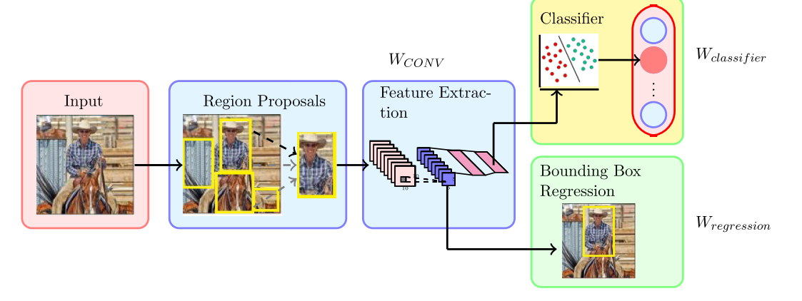
Object Detection and Recognition
General frame work is first detect the Object
Then, perform object classification or recognition step
How about predicting bounding box also

Slide 16
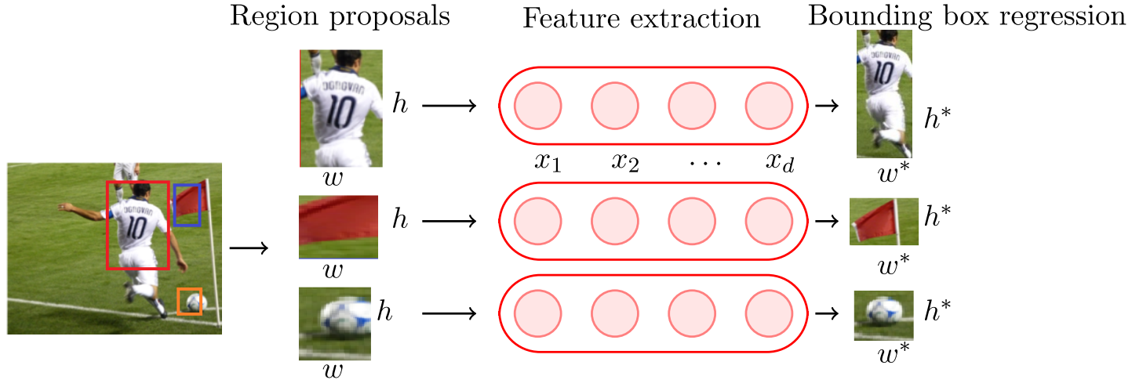
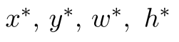
Object Detection and Recognition
General frame work is first detect the Object
Then, perform object classification or recognition step
How about predicting bounding box also
It may improve bounding box from proposed region

Slide 17
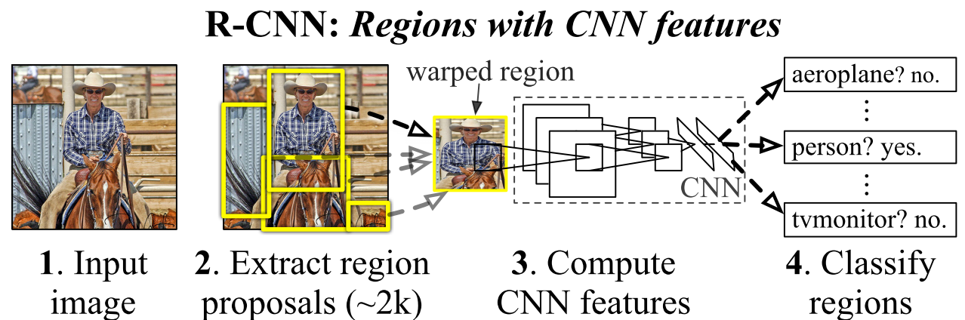
R- CNN
Category independent region proposal (object detection)
Then Object Classification
Many different methods available for region proposal. I think this is tough part to do. (Unsupervised Learning !)
Ross Girshick et. al. 2014

Slide 18
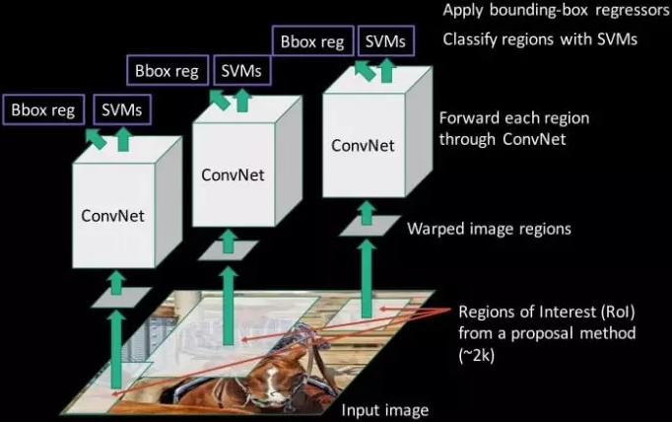
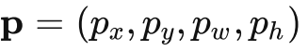
R- CNN
ConvNet as a feature extractor
Linear SVMs as a classifier
Bounding Box regression
Ross Girshick et. al. 2014

Slide 19
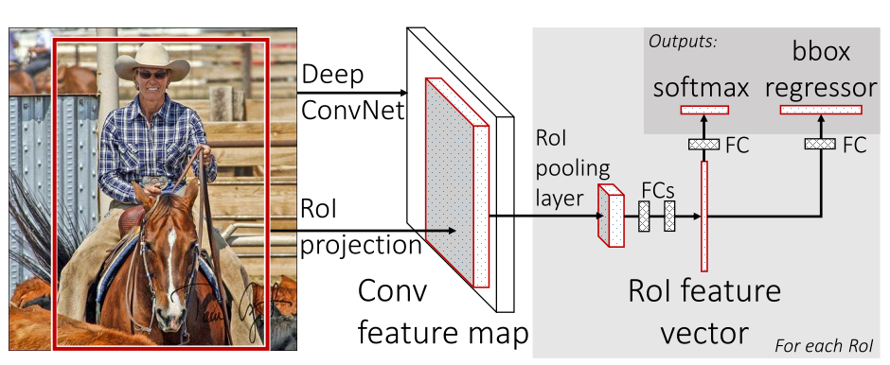
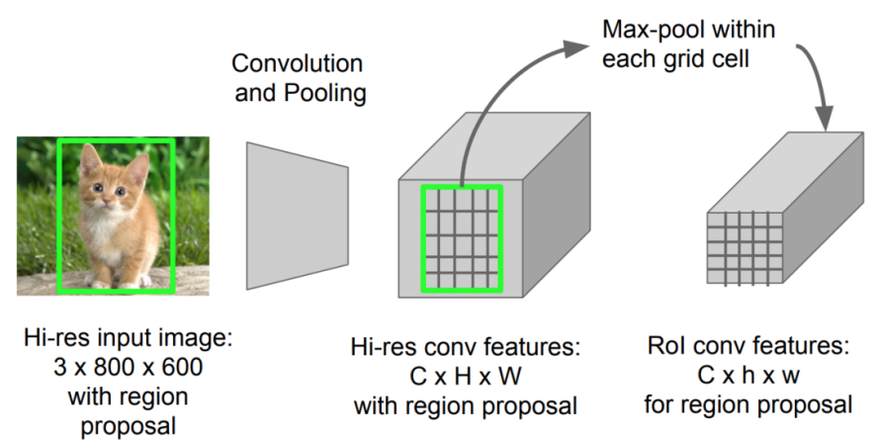
Fast R- CNN
Instead of Image, proposed bounding box project to activation map and warped using max pooling
Classification using CNN
Bounding box regression
Ross Girshick et. al. 2015

Slide 20
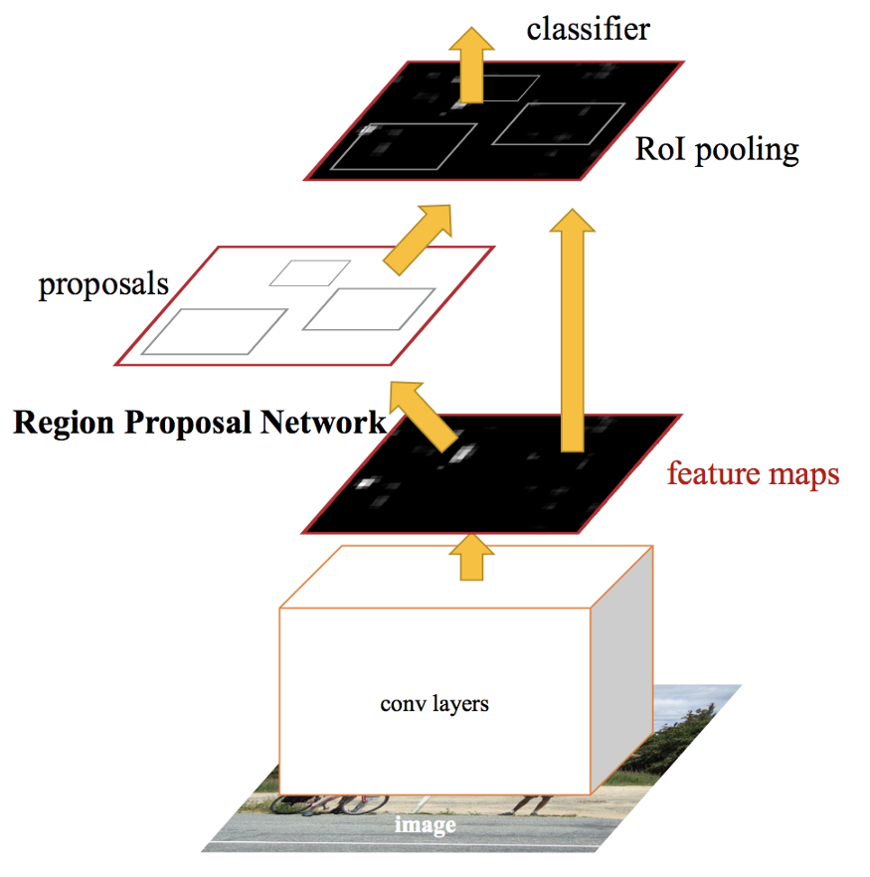
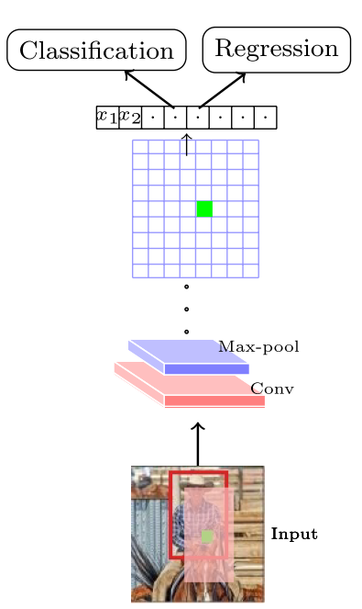
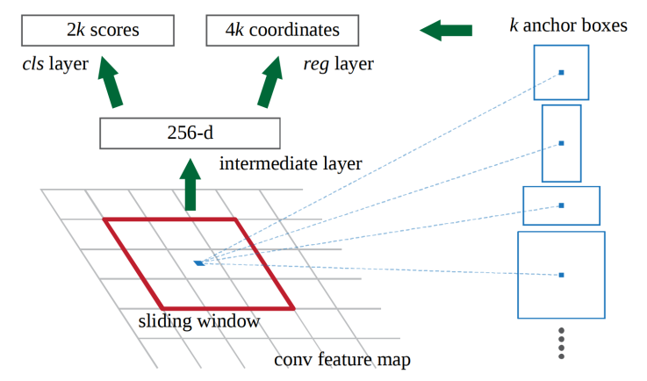

Faster R- CNN
Region Proposal is the bottleneck in R-CNN
In faster R-CNN, Region Proposal is performed using CNN
P(object)
(x,y,h,w)
Shaoqing Ren et al 2016
(Region Proposal Network )

Slide 21
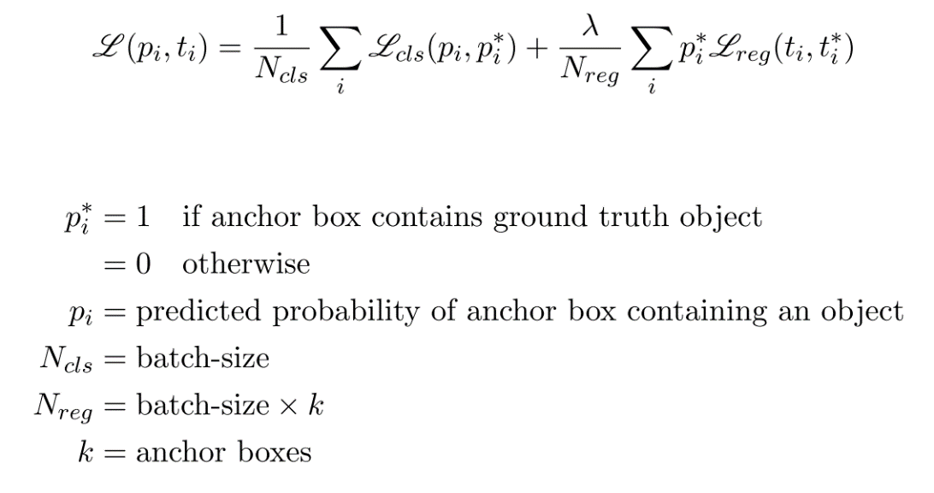

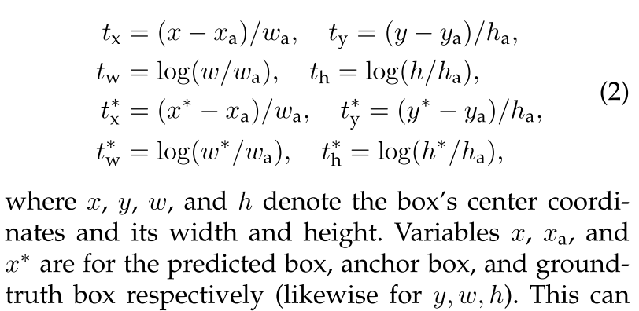
Faster R- CNN
Regions proposal network loss
k=9
(Similar anchor box and bounding box regression concept were used in advance version of the Yolo)
Shaoqing Ren et al 2016

Slide 22
Faster R- CNN
Proposed multiple regions using Regions proposal network
It can be followed by Non-Maximal Suppression (NMS) to reduce number of region proposals
Once we have region proposal, then, apply Fast-R-CNN
Shaoqing Ren et al 2016

Slide 23
Non-Maximum Suppression- NMS
It is likely that there are multiple overlapping bounding box prediction for same object
We need to prune bounding box with lesser confidence and higher IoU with bounding box with higher confidence for a given object class
For more detail please look at : https://www.analyticsvidhya.com/blog/2020/08/selecting-the-right-bounding-box-using-non-max-suppression-with-implementation/ or other resources

Slide 24
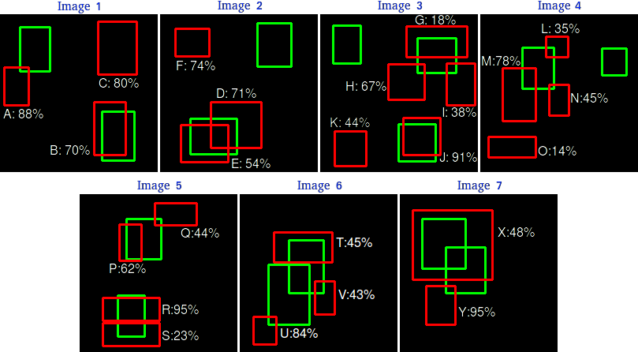
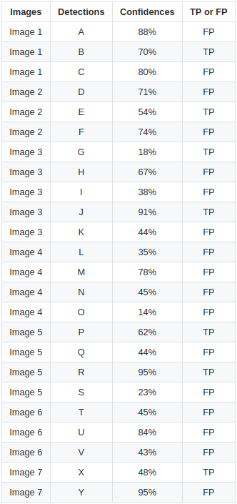
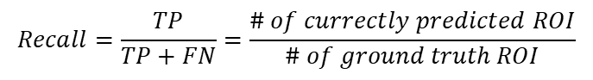
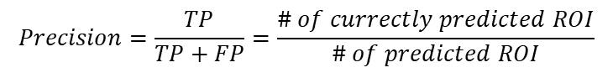
Precision and Recall
$$Precision=\frac{TP}{TP+FP}=\frac{\# of currectly predicted ROI}{\# of predicted ROI}$$
$$Recall=\frac{TP}{TP+FN}=\frac{\# of currectly predicted ROI}{\# of ground truth ROI}$$
Source: https://github.com/rafaelpadilla/Object-Detection-Metrics

Slide 25
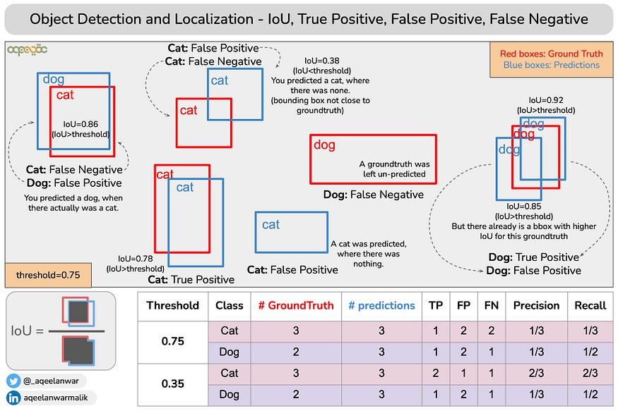
Precision and Recall

Slide 26
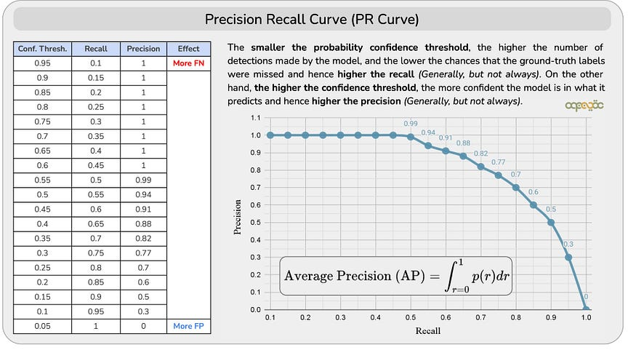
Recision-Recall Curve

